Slide 1
An Overview of Pre-ETS and Vocational Rehabilitation Transition Services

Slide 2
What is DARS?
Department for Aging and Rehabilitative Services (DARS)
Division of Rehabilitative Services
Division of Community Living
Adult Protective Services Division
Disability Determination Services
Division of Aging Services
Long Term Care Ombudsman

Slide 3
Division of Rehabilitative Services
Virginia’s general vocational rehabilitation (VR) agency that assists people with disabilities to prepare for, secure, retain, or regain employment.
Committed to ensuring individuals with disabilities have opportunities to compete for and enjoy high-quality employment.
Services include assistance to students with disabilities.

Slide 4
Schools and DRS
Schools and DRS share a common goal of successful employment outcomes.
Federal regulations require schools and DRS to work together to offer and deliver Pre-ETS.
Pre-ETS works in conjunction with the school’s existing transition services and are based on the student’s individual need.

Slide 5
What are Pre-ETS?
Early start at developing employability skills & assist students with identifying career interests at no cost to families.
Only for Students With Disabilities (SWDs).
Do not have to apply to be a VR client.
DRS collaborates with students, families, schools, and community service providers.

Slide 6
Student Criteria for Pre-ETS
Pre-ETS may be provided to students enrolled in school who…
Are at least 14 AND
Are receiving special education services and have an IEP, OR
Have a Section 504 plan, OR
Have a disability not served by other means from the school and can provide documentation of disability.

Slide 7
Pre-ETS Referrals
How are students referred for Pre-ETS?
Students can be referred for Pre-ETS by the school, parents, or other service provider.
Pre-ETS Information Release and Consent form needs to be completed and signed.
Consent form and documentation of disability are submitted to the Vocational Rehabilitation Counselor.

Slide 8
Pre-ETS Activities
There are five Required Pre-ETS Activities:
Job exploration counseling
Work-based learning experiences
Counseling on opportunities for enrollment in post-secondary education
Workplace readiness training
Instruction in self-advocacy

Slide 9
Job Exploration Counseling
Purpose
Foster motivation, consideration of opportunities, and informed decision making.
Examples
Explore the world of work
Explore interests and abilities
Investigate careers

Slide 10
Work-Based Learning Experiences
Purpose
An educational approach to provide students with knowledge and skills that help them connect school experiences to real-life work activities and future career opportunities.
Examples
Work site tours
Job shadowing
Informational Interviews
Employer presentations
Job Fairs
Arrange guest speakers who have disabilities and are employed

Slide 11
Counseling on Opportunities for
Enrolling in Post-Secondary Education
Purpose
Gaining an awareness of the wide range of career pathway options and labor market realities and projections.
Examples
Academic and occupational counseling
Courses, applications, and admissions processes
Guidance on the FAFSA process
Referral to resources
Campus visits/tours

Slide 12
Workplace Readiness Training
Purpose
Prepares students for commonly expected skills that employers seek from most employees. Work readiness skills are a set of skills and behaviors that are necessary for any job. Often called soft skills, employability skills, or job readiness skills.
Examples
Employer expectations
Time management
Job seeking/networking
Employment application writing
Interviewing skills
Job retention skills
Workplace communication skills

Slide 13
Instruction in Self-Advocacy
Purpose
Provide students with the ability to effectively communicate, convey, negotiate or assert his/her own interests and/or desires. These skills will be needed in education, workplace, and community settings.
Examples
Arrange for speakers from Independent Living Services
Understanding rights and responsibilities
Requesting services and accommodations
Communicating thoughts, needs, and concerns

Slide 14
Pre-Employment Transition Services are the first step on a continuum of Vocational Rehabilitation services provided by DRS.

Slide 15
The Continuum of Services
What happens when a person no longer wants/needs or qualifies for Pre-ETS?
Apply for Vocational Rehabilitation Services (this can happen any time, based on individual need).
  Complete and sign VR application.
  Eligibility completed by VR Counselor.
Look for employment on their own.
  Use skills gained through Pre-ETS to look for, secure, and maintain employment.
  Still can apply for VR services at any time.

Slide 16
Pre-ETS and VR Transition Services
Pre-ETS
VR Transition Services
Pre-ETS help students get an early start exploring careers of interest and developing foundational skills.
No cost to student/family.
VR Transition services are planned and designed to support students while they pursue their employment goal as they transition out of school.
Some cost VR services may be subject to consumer financial participation.

Slide 17
Vocational Rehabilitation
The VR program helps people with disabilities become prepared for, find, and maintain competitive, integrated employment and live more independently in the community.
VR services are individualized, planned services that the VR counselor and consumer agree are needed to assist the individual in working toward and accomplishing his or her employment goal.
In order to receive VR services, the individual must first apply and become a VR consumer.

Slide 18
Eligibility Criteria for VR Services
Have a physical, mental, or emotional disability.
  If a person isn’t sure they have a disability, we can help make that determination.
The disability interferes with the individual’s ability to find or maintain employment.
The person is willing and able to work and believes that DRS will be helpful.
The individual lives, works, or is a student in VA and is eligible to work in the US.

Slide 19
Examples of VR Services
Counseling and Guidance
Vocational Evaluation
Situational Assessments
On-the-Job Training
Unpaid Work Experiences
Assistive Technology Assessments & Services/Accommodations
Post-secondary Education/Vocational Training
Job Placement
Customized Employment
Job Coach Training Services
Supported Employment
Self-Employment Enterprise
Wilson Workforce and Rehabilitation Center (WWRC)
Support Services

Slide 20
Cost for VR Services
Some VR services are free, while others may require the individual to pay some or all the costs.
The VR Counselor will discuss consumer financial participation and complete a Client Financial Statement.
DRS considers comparable benefits and other funds should be used if they are available.

Slide 21
Steps Toward Employment
Referral for Services
Initial Visit (Intake)
Eligibility Determination
Develop Plan and Determine Services
Prepare for Employment
Job Search and Employment
Case Closure

Slide 22
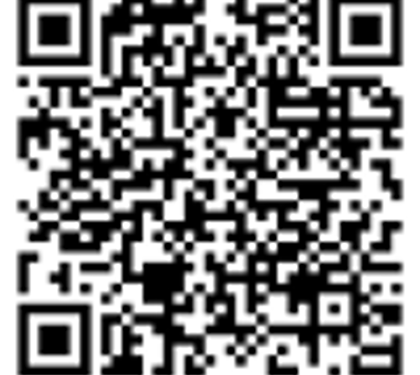
Pre-ETS & VR Transition
Services Webpage
For more information, visit the DARS Pre-ETS and VR Transition Services webpage at
For Students – DARS.

Slide 23
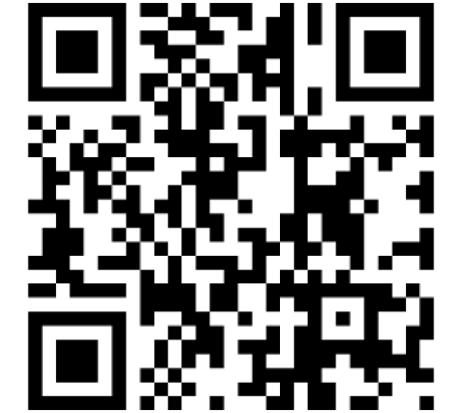
Virginia’s Transition Resource Hub
Did you know that Virginia has a one-stop shop for transition resources? Check out the Transition Resource Hub at https://preets.vcurrtc.org/.

Slide 24
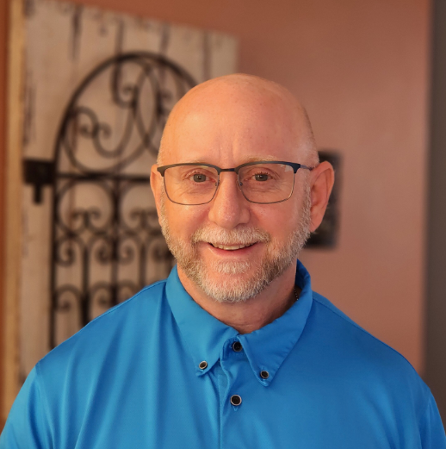


DARS Transition Team
We are here to support you!
TransitionTeam@dars.virginia.gov
Matt Luther
Transition & Education
Services Manager
Patti Hodge
Statewide Transition Specialist
Staff Development
Stephanie Carter
Statewide Transition Specialist
Capacity Development

